Slide 1
Computer Vision
(basic concept)
Anwar khan cs-dept

Slide 2

Overview
1
Image Sampling and Quantization
Basic Concepts in Sampling and Quantization

Slide 3
Image Sampling and Quantization
Basic Concepts
To create a digital image, we need to convert the continuous sensed data into digital form. This involves two processes:
Sampling quantization

Slide 4
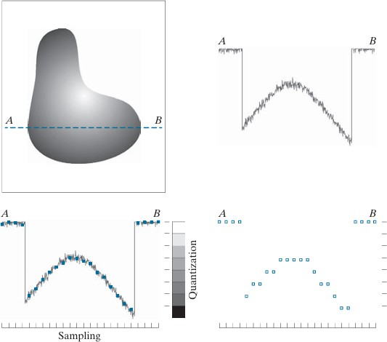
Image Sampling and Quantization
Image Sampling and Quantization
Sampling:
Digitization of the spatial coordinates (x,y)
Quantization:
Digitizing the amplitude values (gray-level quantization
8 bit: 2⁸ = 256 gray levels (0: black, 255: white)
Binary (1 bit): 2 gray levels (0: black, 1: white)
Commonly used number of samples resolution
Digital still cameras:
640x680, 1024, 1024, up to 4064x2704
Digital video cameras:
640x480 at 30 frames/second
1920x1080 at 60 frame/second (HDTV)
8 gray levels

Slide 5
Sampling
Reducing the spatial resolution (down sampling)

Slide 6
Sampling
Resampling the down sampled images to original form (up sampling)

Slide 7
Effect of Sampling and Quantization
250 x 210 samples
256graylevels
125 x 105 samples
50 x 42 samples
25 x 21 samples
16graylevels
8graylevels
4graylevels
Binary image

Slide 8
Effects of Quantization
Effects of varying the number of intensity levels in a digital image (intensity resolution)
16
8
256-level
128
32
4
2
64

Slide 9
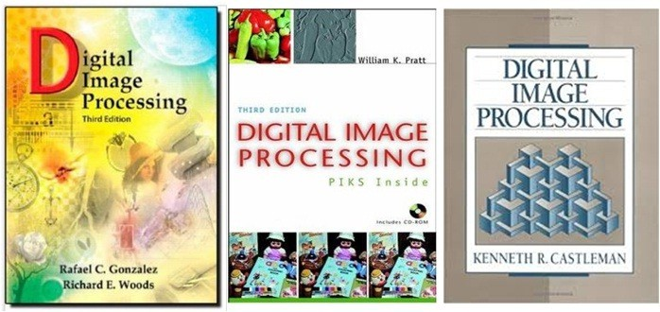
Referred Books
Rafael C. Gonzalez and Richard E. Woods Digital Image Processing
Third Edition
William K. Pratt
Digital Image Processing
Third Edition
Kenneth R. Castleman Digital Image Processing

Slide 10
The End

